Slide 1

Team Details
Team name - NeuroNex
Team members - Sowmya.L.R, Ravi Kumar.K
Problem Statement - Open Innovation in AI - AI in Autism

Slide 2
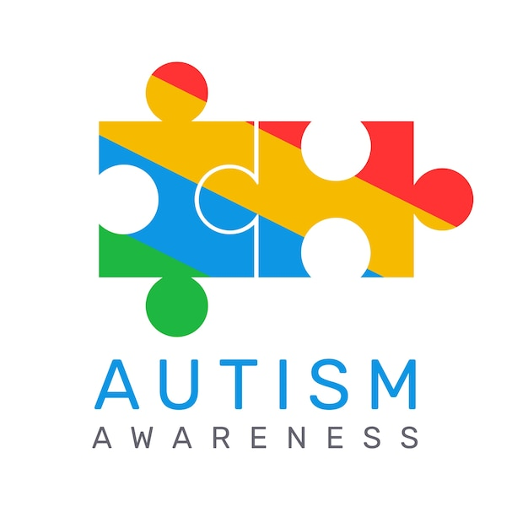
Brief about the problem
Autism is a developmental disorder which affects communication, behavior and social interactions.
Signs for autism can be seen obvious in kids above 2 years of age.
Autism Spectrum Disorder (ASD) cannot be cured. However, early intervention and tailored therapies can significantly improve the quality of life and functional abilities of individuals with autism
Autism

Slide 3
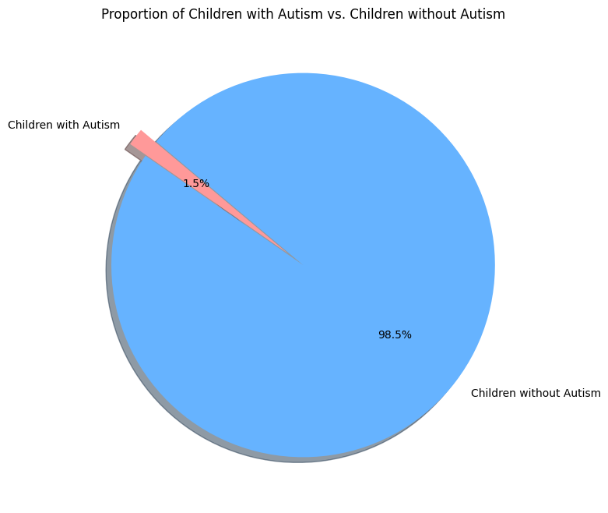
Statistics about autism in India
As per the stats available in UNICEF,
Total children under 5: 113,049,137
Estimated prevalence of autism: 1 in 68
Estimated number of children with autism: 113,049,137 / 68 ≈ 1,662,487
Male-to-female ratio for autism: 3:1

Slide 4
Early Detection
Challenges in Early detection
There are no proper screening tool available for this (since it is a disorder not a disease)
Lack of Awareness: Many parents and caregivers may not be aware of the early signs of Autism, leading to delays in seeking a professional evaluation.
Normal Variability: In early childhood, there is a wide range of development in social, communication, and behaviour skills. Distinguishing typical variations from potential autism symptoms can be tricky.
Limited Access to Resources: In some regions of India, access to specialised healthcare professionals and diagnostic services is limited, hindering early diagnosis efforts for ASD.
Importance of early detectection
Early Intervention: Early diagnosis allows for the implementation of early intervention strategies tailored to the child's specific needs. This can significantly improve their developmental progress in crucial areas like communication, social skills, and behaviour.
Brain Plasticity: In the early years of life, the brain exhibits high plasticity, meaning it can form new connections and adapt more effectively. This period offers a prime opportunity to influence a child's brain development positively. With early detection of ASD, the brain plasticity aspect can be better leveraged to boost the cognitive performance of the child.
Parental Support and Education: Early diagnosis provides parents and caregivers with an understanding of their child's needs and equips them with the knowledge and resources to support their child effectively.

Slide 5
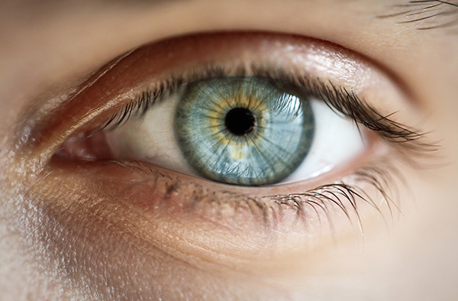

AI in Autism - Computer Vision
Few experts and therapists suggest that just by observing few things with eyes, autistic signs can be inferred from a kid.

Slide 6
Early Autism detector
The app aims to provide a non-invasive, preliminary screening tool to help parents and guardians identify potential signs of autism early, prompting further professional evaluation if necessary.
For making the prototype the dataset is sourced from Kaggle, comprising labeled images of children diagnosed with autism and non-autistic children. (Note: But for making this app we need data from Government of India for differently abled students)
The images focus solely on the faces of the children, ensuring consistency and relevance for the model training.
Once autism spectrum is confirmed further investigation will be done by following a set of questionnaires which will help us to identify on which spectrum that kid is categorised (communication, behavior, social interaction).

Slide 7
Continued..
5. Based on the categories and autism severity range, user will be prompted to provide their location.Based on that input near by therapists and experts details will be shared with them.
6. The stakeholders for this app are meant to be parents, therapists, experts
The above points gives us an overview about the app.

Slide 8
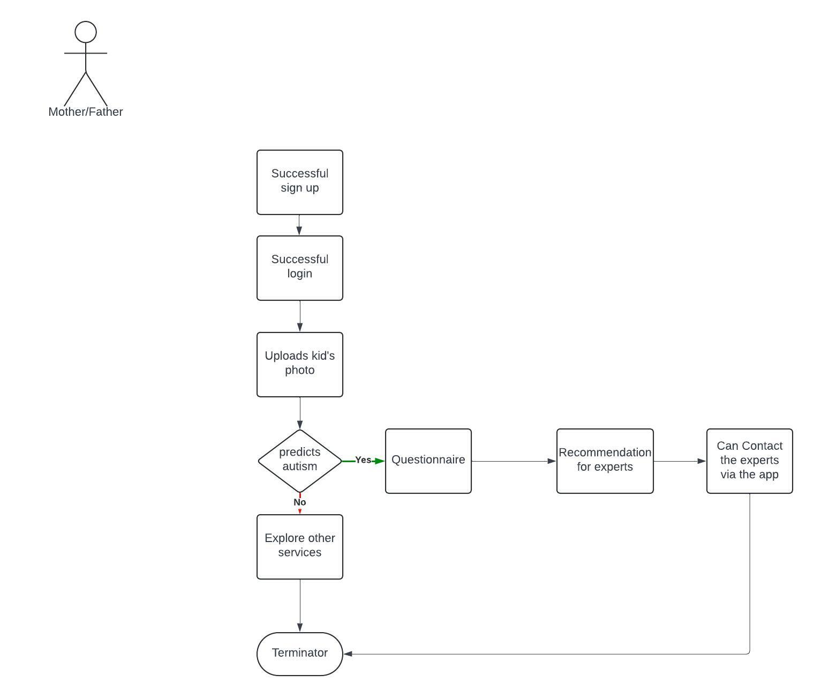
Userflow diagram
Parents first time
Use of the app

Slide 9
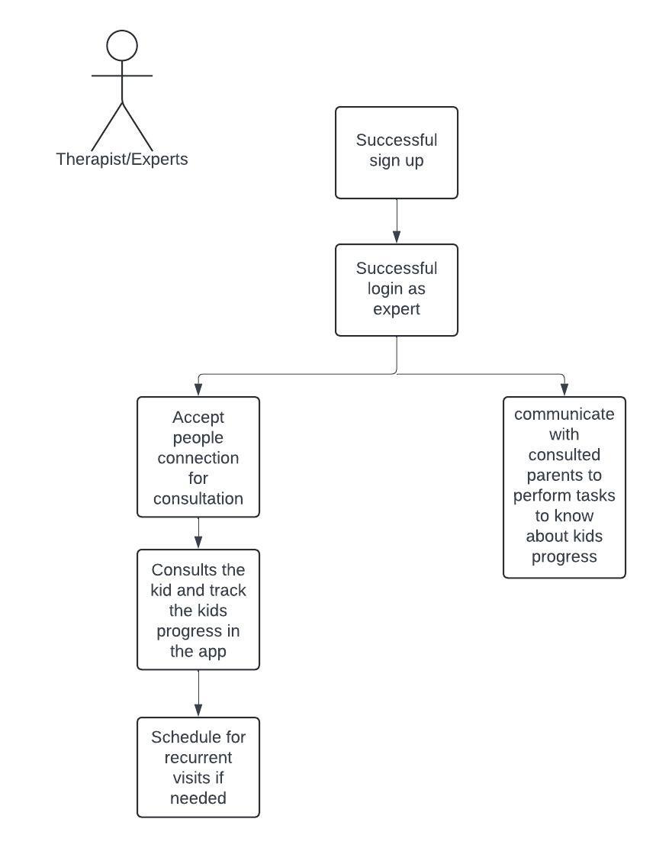
2.Therapists userflow usages

Slide 10
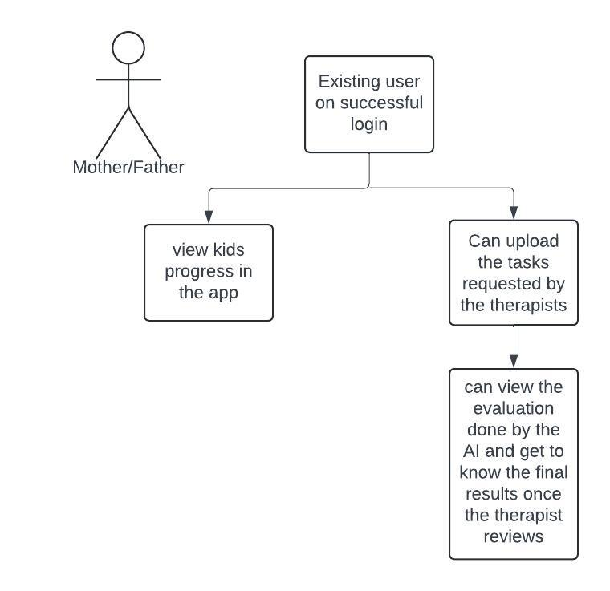
3.Existing parents other
flows

Slide 11
Features available in this app
The stakeholders of this app are Parents(mother, father), teacher(rare persona), therapist, doctors, counsellors.
Parents can use this app as an Autism awareness tool initially. Once people start to use this tool it can gradually becomes the screening tool for this disorder
Experts/Therapists can use the AI features in the app as supporting tool(identifying hand-flapping, highlighting few of the autistic behavior in the uploaded videos of the parents, etc..)
Stakeholders can schedule for recurrent visits with the respective people
Parents and experts can monitor the kid’s progress in the app (kind of tracking the historical behavior of the kid)

Slide 12
Model Selectin and training
Model Variants Evaluated:
ConvNeXtV2-Tiny
ResNet34
VGG16
Best Performing Model: After comprehensive evaluation, ConvNeXtV2-Tiny emerged as the most efficient model for predicting autism in children based on their facial images.

Slide 13
Model Architecture and Design
ConvNeXtV2-Tiny:
Architecture: ConvNeXtV2 is a convolutional neural network (CNN) architecture that integrates design principles from recent advancements in vision transformers. It combines the hierarchical structure of traditional CNNs with elements such as large kernel sizes, depthwise convolutions, and increased channel capacity.
Advantages: This model offers a balanced trade-off between computational efficiency and predictive accuracy, making it suitable for deployment in resource-constrained environments like mobile devices.

Slide 14
Model Training Process
Data Preprocessing:
Normalization: Images were normalized to ensure uniformity.
Augmentation: Applied various augmentation techniques like rotation, flipping, and cropping to enhance model robustness and prevent overfitting.

Slide 15
Training
Framework: Used the fastai vision learner for training the models.
Optimizer: Employed the Adam optimizer for efficient convergence.
Metrics: The error_rate metric was used to monitor and evaluate the model's performance during training.
Epochs and Batch Size: The batch size was set to 32, and the model was trained for 4 epochs.

Slide 16
Model Evaluation
Comparative Analysis:
ConvNeXtV2-Tiny outperformed ResNet34 and VGG16 in terms of both accuracy and computational efficiency.
ResNet34 showed decent performance but lagged in efficiency compared to ConvNeXtV2-Tiny.
VGG16 was less efficient, requiring more computational resources and yielding lower accuracy.
Model Name | Epochs | Error Rate
ConvNeXtV2-Tiny | 4 | 0.108
ResNet34 | 4 | 0.147
VGG16 | 4 | 0.190

Slide 17
Resources for the prototype
Demo video - AI in autism prototype video
App deployed in Huggingface using gradio - autism_detection
Model training source code - kaggle notebook
App source code - huggingface_repo

Slide 18
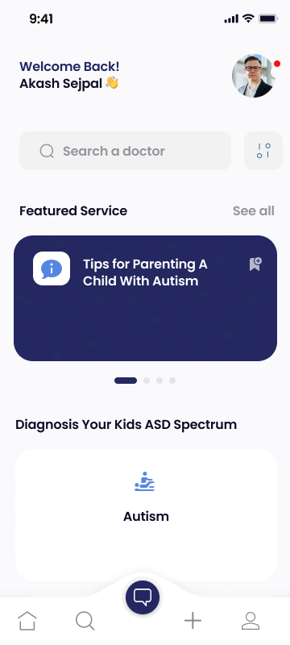
Sample UX designs
Home page

Slide 19
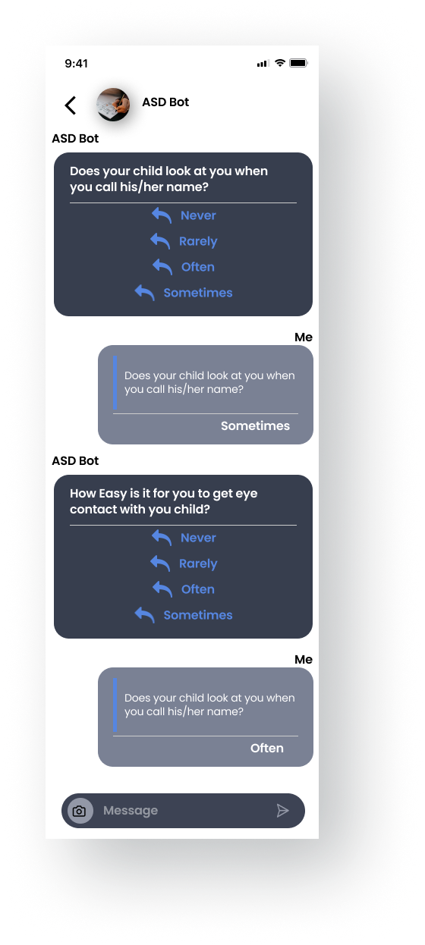
2.

Slide 20
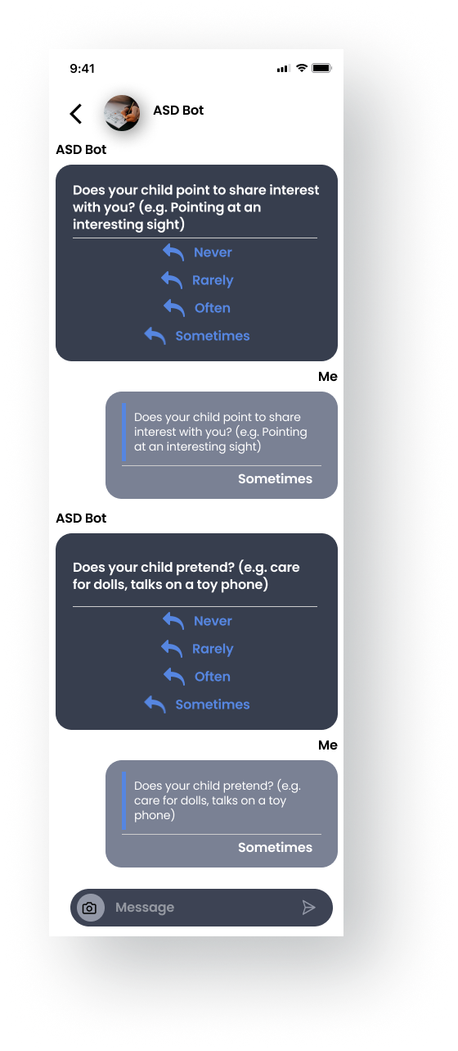

3.

Slide 21


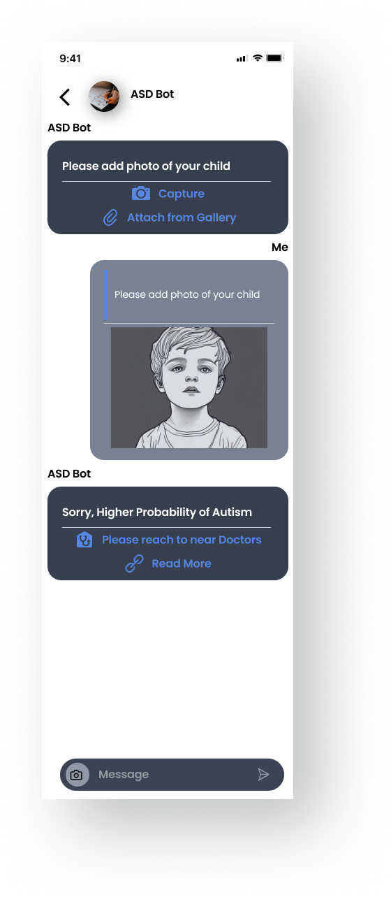

Slide 22


